Slide 1

IoT-Integrated Web-Based Sign Language-to-Speech System for Deaf and Mute Individuals
06 February 2025
Akula Akhil Vignesh CB.SC.U4AIE23303
Prisha Gupta CB.SC.U4AIE23331
Vedant Maheshwari CB.SC.U4AIE23346
Naksh Singh CB.SC.U4AIE23361

Slide 2

/02
Research Gap
Deaf and mute individuals face communication barriers, especially when sign language interpreters are unavailable.
Lack of accessible real-time sign language-to-speech translation in many everyday settings.

Slide 3
/03
Motivation
Enhance communication inclusivity for the deaf and mute community.
Use modern technologies (ML and IoT) to reduce challenges faced by individuals with disabilities.
IoT integration for broader accessibility, disseminating speech to smart speakers and other devices.

Slide 4

/04
Significance
Provides real-time, automated translation of sign language into speech.
Empowers individuals with hearing and speech impairments to communicate effectively.
Accessible and low-cost solution using webcams and machine learning for gesture recognition.

Slide 5
Literature Review
/05
 | TITLE | AUTHOR &YEAR | OUTCOME | LIMITATIONS
1 | An Efficient Speech to Sign Language Conversion and Text Recognition through Live Gesture | M. Kowsigan, R. Dhawan,et.al; 2023 | Efficiently converts sign language into speech and text, making communication easier. It utilizes GGTSAPI, CNN, and Gaussian Kernel for accurate, cost-effective gesture recognition. | Lacks a standardized dataset, affecting accuracy across sign languages. Real-time processing challenges, including potential latency, are not addressed,impacting live communication and limit accessibility.
2 | Mobile Application based Sign Language System for Hearing and Speech Impaired People | Nirmaladevi P;K Manoj Senthil ,et.al ;2023 | Gesture-to-speech systems bridge communication gaps using sensor-based gloves and computer vision models. The ISL Glove, with flex sensors and an Arduino Uno, offers a compact, cost-effective real-time sign translation solution. | Flex sensors lack sensitivity, causing inconsistent gesture recognition and noise, while signal processing struggles with fluctuations. Lack of real-time feedback and M.L challenges with adapting to individual signing styles, with speech synthesis limitations, affect communication clarity.

Slide 6
Literature Review
/06
 | TITLE | JOURNAL & YEAR | OUTCOME | LIMITATIONS
3 | Video-Based Sign Language Translation System Using Machine Learning | B. Sonare, A Padgal, et.al;2023 | Real-time 380x480 images with a white background are processed using the Otsu algorithm for hand segmentation. Feature extraction and PCA improve accuracy, converting recognized signs into text and speech. | High computational power required by CNN and LSTM models makes real-time processing difficult on low-end devices. Variations in lighting, backgrounds, and hand shapes, along with longer gesture sequences, can affect accuracy and lead to inconsistent recognition.
4 | Real Time Detection and Conversion of Gestures to Text and Speech to Sign System | C. U. Om Kumar, K. P. K. Devan,et.al; 2022 | It bridges communication gaps by converting speech to sign language using an RNN-LSTM with CTC, enabling two-way interaction. Gesture recognition is managed by the SSD Mobilenet V2 model, ensuring accessibility for both learning and real-time communication. | As good as the system was, when compared to differnt API’s for which works accurately, the microsft Azure showed poor accuracy,

Slide 7
/07
Literature Review
SL.NO | TITLE | JOURNAL AND YEAR | OUTCOME | LIMITATIONS
5 | Deaf talk using 3D animated sign language: A sign language interpreter using Microsoft's kinect v2 | M. Ahmed, M.Idrees et.al;2016 | Kinect records and recognizes gestures, converts them into keywords, and generates speech using .NET. AdaBoost detects gesture start/end. RFRProgress tracks progress for accuracy. Includes recording, tagging, testing, recognition, and speech conversion. | The system currently works with a limited set of words and requires future expansion of its dictionary. Kinect v2 dependency restricts compatibility to devices that support this hardware. The system does not account for variations in individual signing styles or complex sentence structures.

Slide 8

/08
Objectives
Bridging the Communication Gap
Develop an Edge ML model that enables real-time conversion of sign language into speech.
Ensure low latency and high accuracy to support seamless communication.
Efficient Data Transmission Using MQTT Protocol
Implement the MQTT protocol for lightweight, reliable, and fast data transfer between the Edge Device (PC), Cloud Server, and Speaker.
Design a publish-subscribe architecture to handle both text and audio data efficiently.

Slide 9
/09
Objectives
Cloud-Based Text Display & Text-to-Speech (TTS) Conversion
Convert the recognized text into natural-sounding speech to enable clear, communication.
Integrate a Text-to-Speech (TTS) engine on the cloud to convert text into audio output.
Efficient and Scalable Solution
Utilize a combination of machine learning, IoT, and cloud-based processing to ensure an accurate and efficient conversion process.
Maintain modularity to ensure that each component (Edge Model, MQTT, Cloud, TTS, Speaker) can be upgraded independently.

Slide 10
/10
Objectives
Seamless Audio Output to IoT Speaker:
Transmit the synthesized audio from the cloud to the IoT speaker via MQTT for instant speech output.
Ensure clear and natural voice synthesis, making communication accessible to non-sign language users.
Promoting Accessibility
Bridge the communication gap between the hearing-impaired and the general population.
Provide an inclusive, real-time assistive tool that enhances accessibility in various online as well as offline platforms

Slide 11
/11
Expected Outcome
Real-Time Sign-to-Speech Conversion
Achieve real-time translation of sign language gestures into both text and speech with minimal delay
The system will accurately recognize common sign language gestures and deliver corresponding audio output through an IoT speaker.
Interactive Cloud Dashboard
The dashboard will support remote monitoring, history tracking, and system diagnostics for better performance analysis
A web-based interface will display the recognized text in real-time, offering a clear and accessible communication medium.

Slide 12
/12
Expected Outcome
Reliable IoT Communication with MQTT
Establish a robust MQTT-based communication system that ensures fast, secure, and reliable data transfer even in low-bandwidth environments.
Demonstrates the power of IoT protocols and bi-directional communication.
Ensures real-time communication between the Edge device and the cloud
Cloud Processing & Text-to-Speech (TTS) Conversion
The cloud platform processes the received text and converts it into speech using a TTS engine.
The generated speech is sent back to the edge device (speaker) using MQTT publish-subscribe architecture.
Enables hands-free, real-time audio output.

Slide 13
/13
Machine Learning
Data Pre-processing and Feature Extraction:
Feature Extraction is done to extract meaningful features from images (hand gestures). This step helps transform raw pixel data into a format suitable for machine learning models, often using techniques like image thresholding, landmark detection, and background normalization.

Slide 14
/14
Machine Learning
Gesture Classification:
Convolutional Neural Networks (CNNs) are applied for gesture classification, which is essential for recognizing the hand signs in American Sign Language (ASL).
CNNs are particularly effective for image recognition tasks because they can automatically detect spatial hierarchies in images, such as edges, shapes, and complex patterns in hand gestures.
The CNN model is trained on a dataset of hand gestures, allowing it to learn and classify different ASL signs based on their visual features.

Slide 15
/15
Machine Learning
Text and Speech Translation:
Text Translation: Once a gesture is classified, it is mapped to its corresponding letter or word. This mapping is a simple classification task that feeds into a textual output system.
Speech Translation: After identifying the sign language gesture, it is converted to text, which is then synthesized into speech. For this, ML models like text-to-speech (TTS) systems are employed to convert text into audio output.

Slide 16
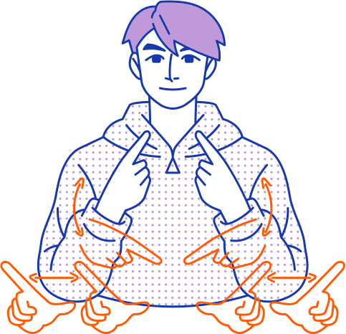
/16
Communication & IoT
Communication Flow Overview
Webcam captures sign language gestures and sends data to the website.
Computer processes the video using an ML model and converts it into text.
Text-to-Speech (TTS) converts the text into audio speech.
Speech data is sent to a smart speaker via MQTT (IoT protocol) for playback.

Slide 17
/17
Communication & IoT
Webcam (Data Capture) → Computer
How It Works:
Webcam captures real-time sign language gestures.
Converts video frames into digital signals.
Transmits data to the webpage.

Slide 18
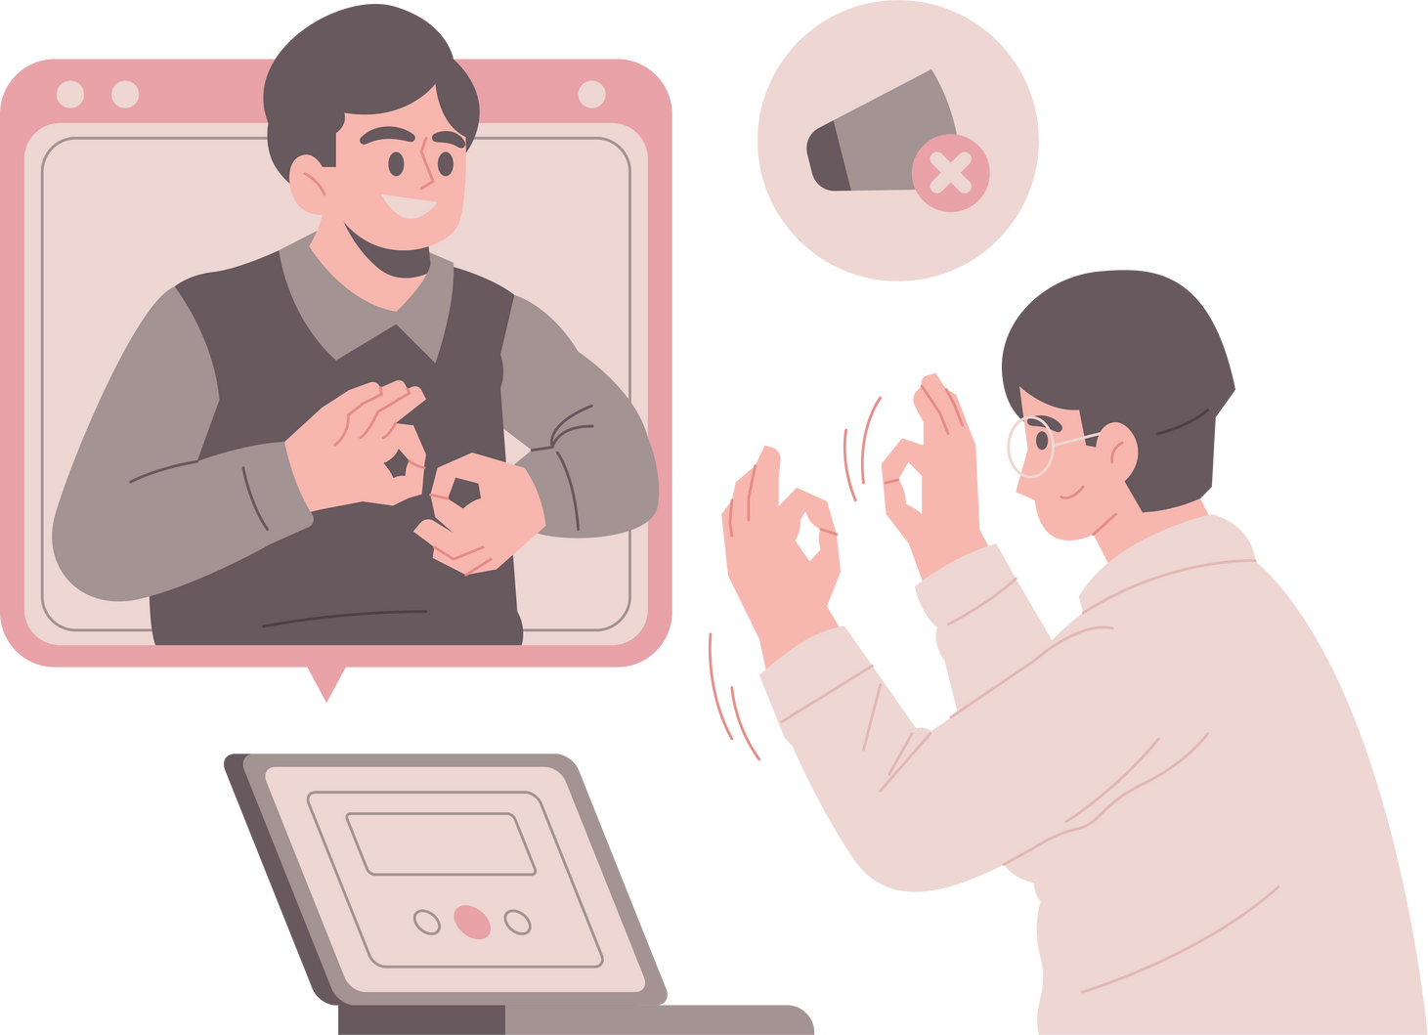
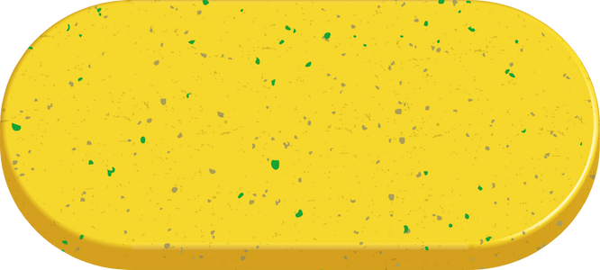
/18
Communication & IoT
MQTT (Message Queuing Telemetry Transport)-:
It is a messaging protocol that allows devices to communicate with each other over the internet. It's often used for Internet of Things (IoT) devices, such as sensors Efficient Data Transfer
How it works ?
MQTT uses a publish-subscribe (Pub/Sub) model.
The sender (publisher) sends data to a topic.
The receiver (subscriber) receives data from the topic.
Broker
Publisher
Topic
Subscriber

Slide 19
/19
Communication & IoT
Web Integration:
A web-based interface allows real-time display of the captured video and interacts with the system, ensuring user accessibility
Voice Output via IoT:
Translated text is converted to speech and sent to a smart speaker, offering an accessible feedback mechanism for users.

Slide 20
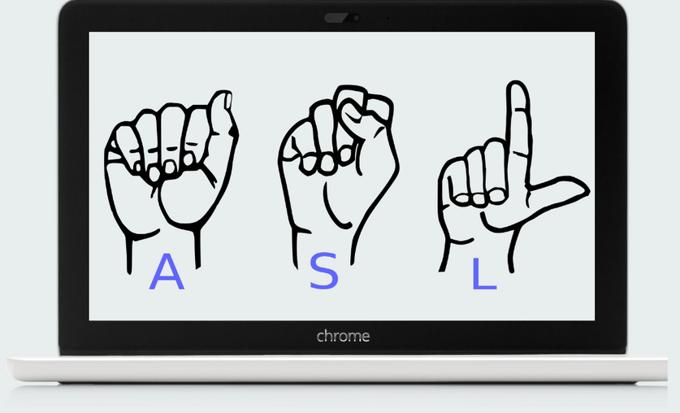
/20
Communication & IoT
Device Interoperability:
The project leverages the principles of the Web of Things (WoT) for smooth integration of multiple IoT devices, ensuring a cohesive system with varied communication methods.

Slide 21
/21
References
1)M. Kowsigan, R. Dhawan and A. Kundu, "An Efficient Speech to Sign Language Conversion and Text Recognition through Live Gesture," 2024 IEEE International Conference on Smart Power Control and Renewable Energy (ICSPCRE), Rourkela, India, 2024 [1]
2)N. P, M. S. K, P. M, B. H, J. S. T. S and M. V, "Mobile Application based Sign Language System for Hearing and Speech Impaired People," 2023 14th International Conference on Computing Communication and Networking Technologies (ICCCNT), Delhi, India, 2023 [2]
3)B. Sonare, A. Padgal, Y. Gaikwad and A. Patil, "Video-Based Sign Language Translation System Using Machine Learning," 2021 2nd International Conference for Emerging Technology (INCET), Belagavi, India, 2021 [3]
4)C. U. Om Kumar, K. P. K. Devan, P. Renukadevi, V. Balaji, A. Srinivas and R. Krithiga, "Real Time Detection and Conversion of Gestures to Text and Speech to Sign System," 2022 3rd International Conference on Electronics and Sustainable Communication Systems (ICESC), Coimbatore, India, 2022 [4]
5)M. Ahmed, M. Idrees, Z. ul Abideen, R. Mumtaz and S. Khalique, "Deaf talk using 3D animated sign language: A sign language interpreter using Microsoft's kinect v2," 2016 SAI Computing Conference (SAI), London, UK, 2016 [5]

Slide 22


/22
Thank You

